Slide 1
Sequences, and Sums

Slide 2

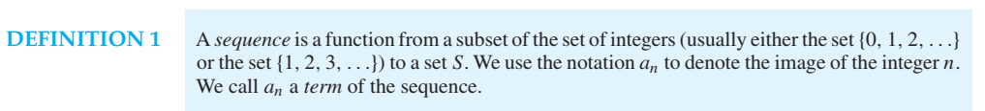
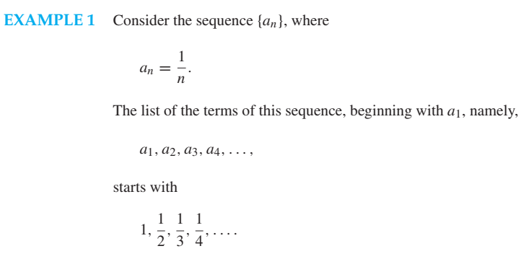
2.4 Sequences and Summations

Slide 3
2.4 Sequences and Summations
DEFINITION 2
A geometric progression is a sequence of the form
a, ar, ar², …, ar^{n}, …
where the initial term a and the common ratio r are real numbers.
Example: The following sequence are geometric progressions.
{b_{n}} with b_{n} = (-1)^{n} starts with 1, -1, 1, -1, 1, …
initial term: 1, common ratio: -1
{c_{n}} with c_{n} = 2*5^{n} starts with 2, 10, 50, 250, 1250, …
initial term: 2, common ratio: 5
{d_{n}} with d_{n} = 6 *(1/3)^{n} starts with 6,2, 2/3, 2/9, 2/27, …
initial term: 6, common ratio: 1/3

Slide 4
2.4 Sequences and Summations
DEFINITION 3
A arithmetic progression is a sequence of the form
a, a + d, a + 2d, …, a + nd, …
where the initial term a and the common difference d are real numbers.
Example: The following sequence are arithmetic progressions.
{s_{n}} with s_{n} = -1 + 4n starts with -1, 3, 7, 11,…
initial term: -1, common difference: 4
{t_{n}} with t_{n} = 7 – 3n starts with 7, 4, 1, -2, …
initial term: 7, common difference: -3

Slide 5
2.4 Sequences and Summations
Example: Find formulae for the sequences with the following first five terms
(a). 1, 1/2, 1/4, 1/8, 1/16
Solution: a_{n} = 1/2^{n}
(b). 1, 3, 5, 7, 9
Solution: a_{n} = 2* n + 1
(c). 1, -1, 1, -1, 1
Solution: a_{n} = (-1)^{n}

Slide 6
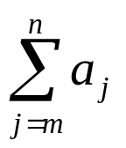
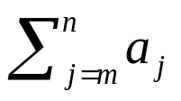
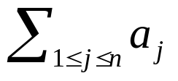
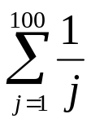
2.4 Sequences and Summations
Summations
The sum of the terms from the sequence {a_{n}} a_{m} + a_{m+1}, …, a_{n} can be expressed as
^{, Or}
Example:
Express the sum of the first 100 terms of the sequence {a_{n}}, where a_{n} = 1/n for n = 1,2,3, ….
Solution:

Slide 7
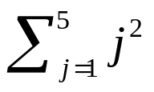
2.4 Sequences and Summations
What is the value of ?
Solution:
= 1 + 4 + 9 + 16 + 25 = 55

Slide 8
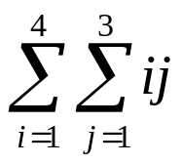
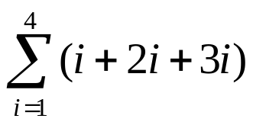
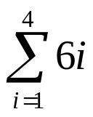
2.4 Sequences and Summations
What is the value of the double summation ?
Solution:
=
= = 6 + 12 + 18 + 24 = 60

Slide 9
Counting

Slide 10
Basic Counting Principles
Counting problems are of the following kind:
“How many different 8-letter passwords are there?”
“How many possible ways are there to pick 11 soccer players out of a 20-player team?”
Most importantly, counting is the basis for computing probabilities of discrete events.
(“What is the probability of winning the lottery?”)
Fall 2002
CMSC 203 - Discrete Structures

Slide 11
Basic Counting Principles
The sum rule:
If a task can be done in n₁ ways and a second task in n₂ ways, and if these two tasks cannot be done at the same time, then there are n₁ + n₂ ways to do either task.
Example:
The department will award a free computer to either a CS student or a CS professor.
How many different choices are there, if there are 530 students and 15 professors?
There are 530 + 15 = 545 choices.
Fall 2002
CMSC 203 - Discrete Structures

Slide 12
Basic Counting Principles
Generalized sum rule:
If we have tasks T₁, T₂, …, T_{m} that can be done in n₁, n₂, …, n_{m} ways, respectively, and no two of these tasks can be done at the same time, then there are n₁ + n₂ + … + n_{m} ways to do one of these tasks.
Fall 2002
CMSC 203 - Discrete Structures

Slide 13
Basic Counting Principles
The product rule:
Suppose that a procedure can be broken down into two successive tasks. If there are n₁ ways to do the first task and n₂ ways to do the second task after the first task has been done, then there are n₁n₂ ways to do the procedure.
Fall 2002
CMSC 203 - Discrete Structures

Slide 14
Basic Counting Principles
Example:
How many different license plates are there that containing exactly three English letters ?
Solution:
There are 26 possibilities to pick the first letter, then 26 possibilities for the second one, and 26 for the last one.
So there are 26⋅26⋅26 = 17576 different license plates.
Fall 2002
CMSC 203 - Discrete Structures

Slide 15
Basic Counting Principles
Generalized product rule:
If we have a procedure consisting of sequential tasks T₁, T₂, …, T_{m} that can be done in n₁, n₂, …, n_{m} ways, respectively, then there are n₁ ⋅ n₂ ⋅ … ⋅ n_{m} ways to carry out the procedure.
Fall 2002
CMSC 203 - Discrete Structures

Slide 16
Basic Counting Principles
The sum and product rules can also be phrased in terms of set theory.
Sum rule: Let A₁, A₂, …, A_{m} be disjoint sets. Then the number of ways to choose any element from one of these sets is |A₁ ∪ A₂ ∪ … ∪ A_{m} | =
|A₁| + |A₂| + … + |A_{m}|.
Product rule: Let A₁, A₂, …, A_{m} be finite sets. Then the number of ways to choose one element from each set in the order A₁, A₂, …, A_{m} is
|A₁ × A₂ × … × A_{m} | = |A₁| ⋅ |A₂| ⋅ … ⋅ |A_{m}|.
Fall 2002
CMSC 203 - Discrete Structures

Slide 17
Inclusion-Exclusion
How many bit strings of length 8 either start with a 1 or end with 00?
Task 1: Construct a string of length 8 that starts with a 1.
There is one way to pick the first bit (1),
two ways to pick the second bit (0 or 1),
two ways to pick the third bit (0 or 1),
.
.
.
two ways to pick the eighth bit (0 or 1).
Product rule: Task 1 can be done in 1⋅2⁷ = 128 ways.
Fall 2002
CMSC 203 - Discrete Structures

Slide 18
Inclusion-Exclusion
Task 2: Construct a string of length 8 that ends with 00.
There are two ways to pick the first bit (0 or 1),
two ways to pick the second bit (0 or 1),
.
.
.
two ways to pick the sixth bit (0 or 1),
one way to pick the seventh bit (0), and
one way to pick the eighth bit (0).
Product rule: Task 2 can be done in 2⁶ = 64 ways.
Fall 2002
CMSC 203 - Discrete Structures

Slide 19
Inclusion-Exclusion
Since there are 128 ways to do Task 1 and 64 ways to do Task 2, does this mean that there are 192 bit strings either starting with 1 or ending with 00 ?
No, because here Task 1 and Task 2 can be done at the same time.
When we carry out Task 1 and create strings starting with 1, some of these strings end with 00.
Therefore, we sometimes do Tasks 1 and 2 at the same time, so the sum rule does not apply.
Fall 2002
CMSC 203 - Discrete Structures

Slide 20
Inclusion-Exclusion
If we want to use the sum rule in such a case, we have to subtract the cases when Tasks 1 and 2 are done at the same time.
How many cases are there, that is, how many strings start with 1 and end with 00?
There is one way to pick the first bit (1),
two ways for the second, …, sixth bit (0 or 1),
one way for the seventh, eighth bit (0).
Product rule: In 2⁵ = 32 cases, Tasks 1 and 2 are carried out at the same time.
Fall 2002
CMSC 203 - Discrete Structures

Slide 21
Inclusion-Exclusion
Since there are 128 ways to complete Task 1 and 64 ways to complete Task 2, and in 32 of these cases Tasks 1 and 2 are completed at the same time, there are
128 + 64 – 32 = 160 ways to do either task.
In set theory, this corresponds to sets A₁ and A₂ that are not disjoint. Then we have:
|A₁ ∪ A₂| = |A₁| + |A₂| - |A₁ ∩ A₂|
This is called the principle of inclusion-exclusion.
Fall 2002
CMSC 203 - Discrete Structures

Slide 22
Tree Diagrams
How many bit strings of length four do not have two consecutive 1s?
Task 1 Task 2 Task 3 Task 4
(1st bit) (2nd bit) (3rd bit) (4th bit)
0
0
0
1
0
1
0
1
0
0
1
0
0
1
0
1
1
0
There are 8 strings.
Fall 2002
CMSC 203 - Discrete Structures

Slide 23
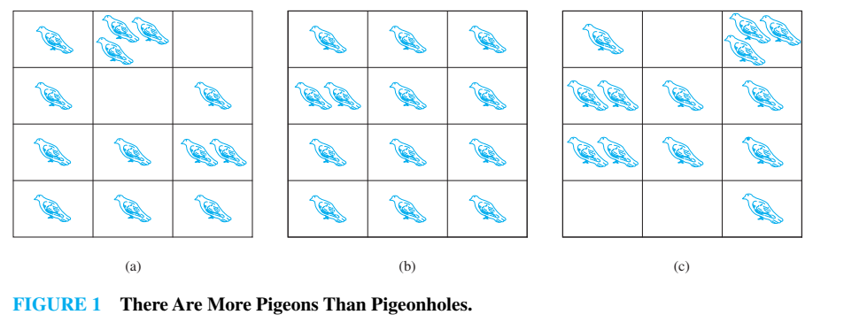
The Pigeonhole Principle
The pigeonhole principle: If (k + 1) or more objects are placed into k boxes, then there is at least one box containing two or more of the objects.
Fall 2002
CMSC 203 - Discrete Structures

Slide 24
The Pigeonhole Principle
Example 1: If there are 11 players in a soccer team that wins 12-0, there must be at least one player in the team who scored at least twice.
Example 2: If you have 6 classes from Monday to Friday, there must be at least one day on which you have at least two classes.
Example 3: How many students must be in a class to guarantee that at least two students receive the same score on the final exam, if the exam is graded on a scale from 0 to 100 points?
  Solution: There are 101 possible scores on the final. The pigeonhole principle shows that among any 102 students there must be at least 2 students with the same score.
Fall 2002
CMSC 203 - Discrete Structures

Slide 25
The Pigeonhole Principle
The generalized pigeonhole principle: If N objects are placed into k boxes, then there is at least one box containing at least ⎡N/k⎤ of the objects.
Example 1: What is the minimum number of students required in a discrete mathematics class (60-student class) to be sure that at least six will receive the same grade, if there are five possible grades, A, B, C, D, and F?
  In our 60-student class, at least 12 students will get the same letter grade (A, B, C, D, or F). 60/5=12
Fall 2002
CMSC 203 - Discrete Structures

Slide 26
Permutations and Combinations
How many ways are there to pick a set of 3 people from a group of 6?
There are 6 choices for the first person, 5 for the second one, and 4 for the third one, so there are
6⋅5⋅4 = 120 ways to do this.
This is not the correct result!
For example, picking person C, then person A, and then person E leads to the same group as first picking E, then C, and then A.
However, these cases are counted separately in the above equation.
Fall 2002
CMSC 203 - Discrete Structures

Slide 27
Permutations and Combinations
So how can we compute how many different subsets of people can be picked (that is, we want to disregard the order of picking) ?
To find out about this, we need to look at permutations.
A permutation of a set of distinct objects is an ordered arrangement of these objects.
An ordered arrangement of r elements of a set is called an r-permutation.
Fall 2002
CMSC 203 - Discrete Structures

Slide 28
Permutations and Combinations
Example: Let S = {1, 2, 3}.
The arrangement 3, 1, 2 is a permutation of S.
The arrangement 3, 2 is a 2-permutation of S.
The number of r-permutations of a set with n distinct elements is denoted by P(n, r).
We can calculate P(n, r) with the product rule:
P(n, r) = n⋅(n – 1)⋅(n – 2) ⋅…⋅(n – r + 1).
(n choices for the first element, (n – 1) for the second one, (n – 2) for the third one…)
Fall 2002
CMSC 203 - Discrete Structures

Slide 29
Permutations and Combinations
Example:
P(8, 3) = 8⋅7⋅6 = 336
= (8⋅7⋅6⋅5⋅4⋅3⋅2⋅1)/(5⋅4⋅3⋅2⋅1)
General formula:
P(n, r) = n!/(n – r)!
Knowing this, we can return to our initial question:
How many ways are there to pick a set of 3 people from a group of 6 (disregarding the order of picking)?
Fall 2002
CMSC 203 - Discrete Structures

Slide 30
Permutations and Combinations
An r-combination of elements of a set is an unordered selection of r elements from the set.
Thus, an r-combination is simply a subset of the set with r elements.
Example: Let S = {1, 2, 3, 4}.
Then {1, 3, 4} is a 3-combination from S.
The number of r-combinations of a set with n distinct elements is denoted by C(n, r).
Example: C(4, 2) = 6, since, for example, the 2-combinations of a set {1, 2, 3, 4} are {1, 2}, {1, 3}, {1, 4}, {2, 3}, {2, 4}, {3, 4}.
Fall 2002
CMSC 203 - Discrete Structures

Slide 31
Permutations and Combinations
How can we calculate C(n, r)?
C(n, r) = P(n, r)/P(r, r)
= n!/(n – r)!/(r!/(r – r)!)
= n!/(r!(n – r)!)
How many ways are there to pick a set of 3 people from a group of 6 (disregarding the order of picking)?
C(6, 3) = 6!/(3!⋅3!) = 720/(6⋅6) = 720/36 = 20
There are 20 different ways, that is, 20 different groups to be picked.
Fall 2002
CMSC 203 - Discrete Structures

Slide 32
Permutations and Combinations
Example:
A soccer club has 8 female and 7 male members. For today’s match, the coach wants to have 6 female and 5 male players on the grass. How many possible configurations are there?
C(8, 6) ⋅ C(7, 5) = 8!/(6!⋅2!) ⋅ 7!/(5!⋅2!)
= 28⋅21
= 588
Fall 2002
CMSC 203 - Discrete Structures

